Slide 1
My Progress
Artificial intelligence model for continuous, in-home, posture and health monitoring including user feedback and predictions of clinical assessment.
David Faith Odesola
11/23/2023

Slide 2
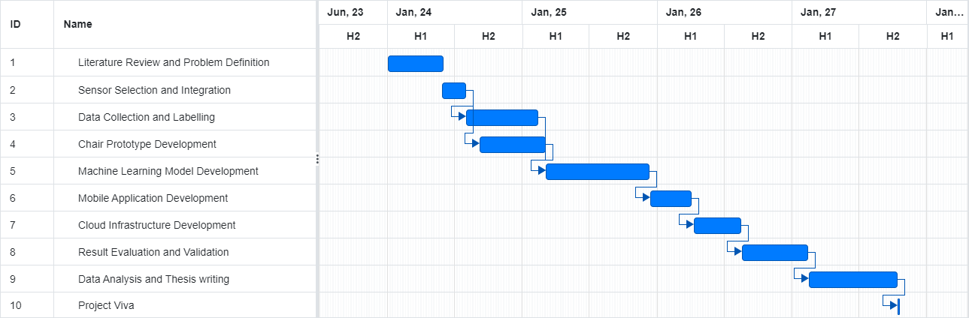
Gantt Chart

Slide 3
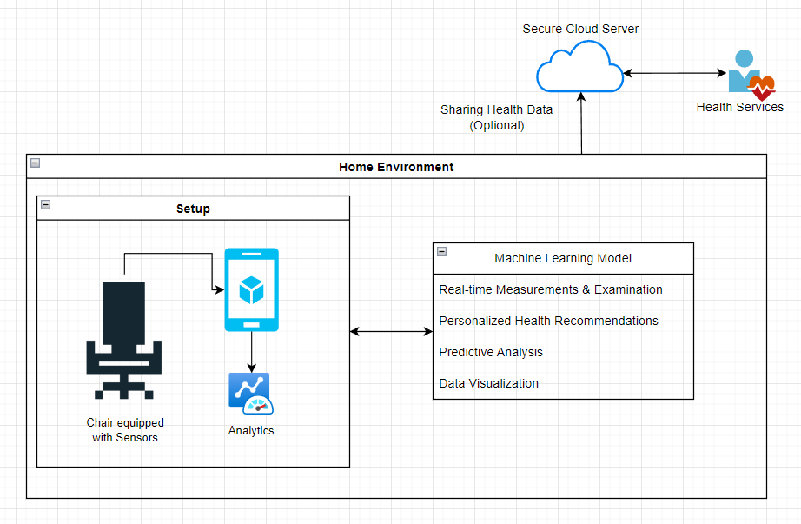

Slide 4

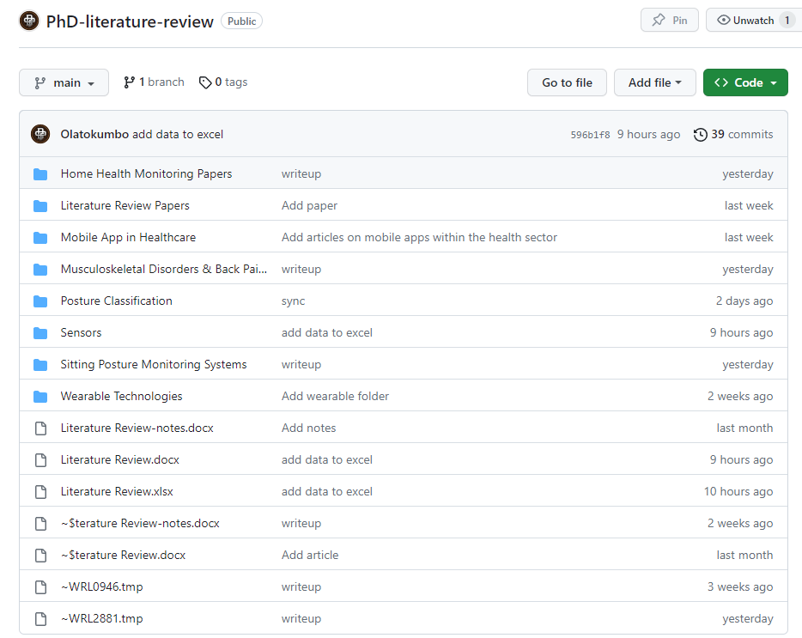
My Literature Review Repo
https://github.com/Olatokumbo/PhD-literature-review

Slide 5
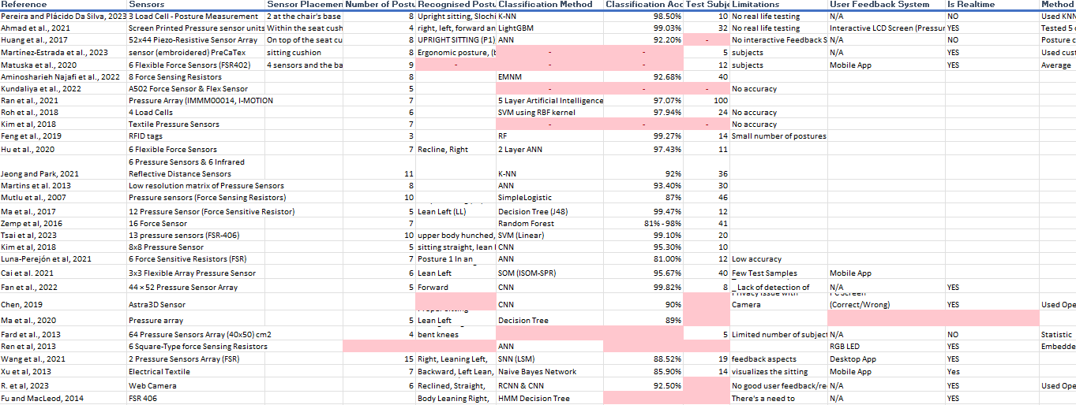
Literature Review
Read through 30+ related papers

Slide 6
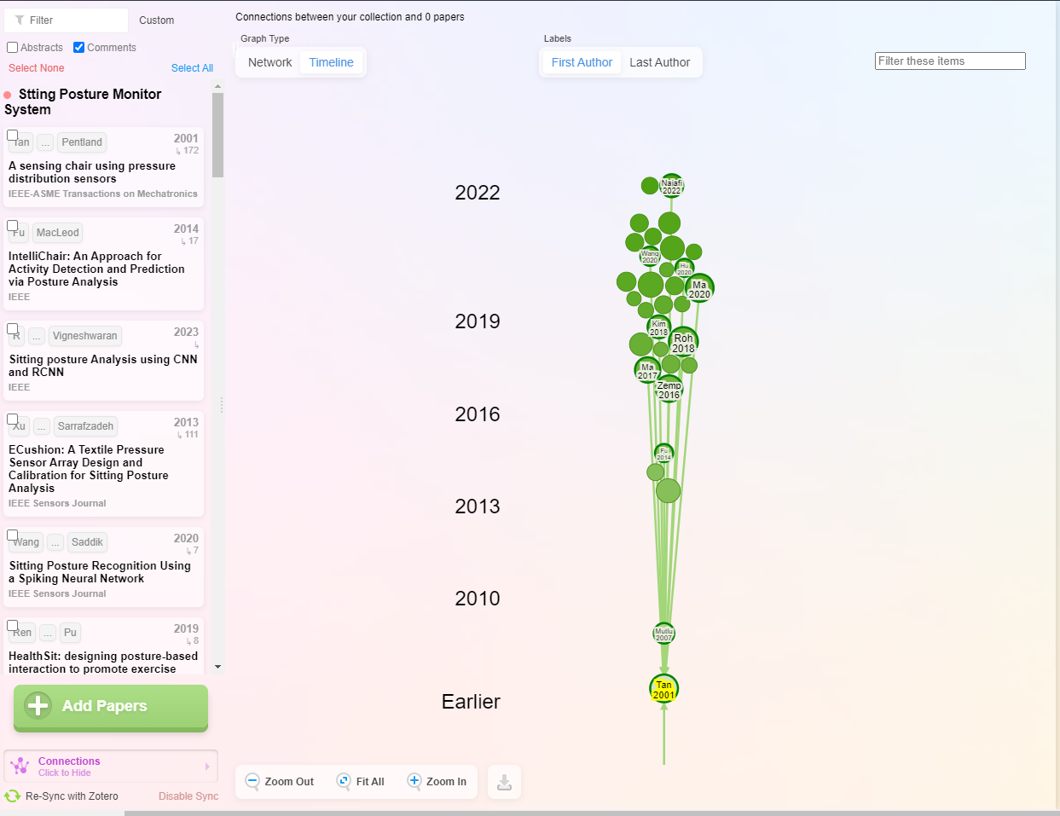
TIMELINE

Slide 7
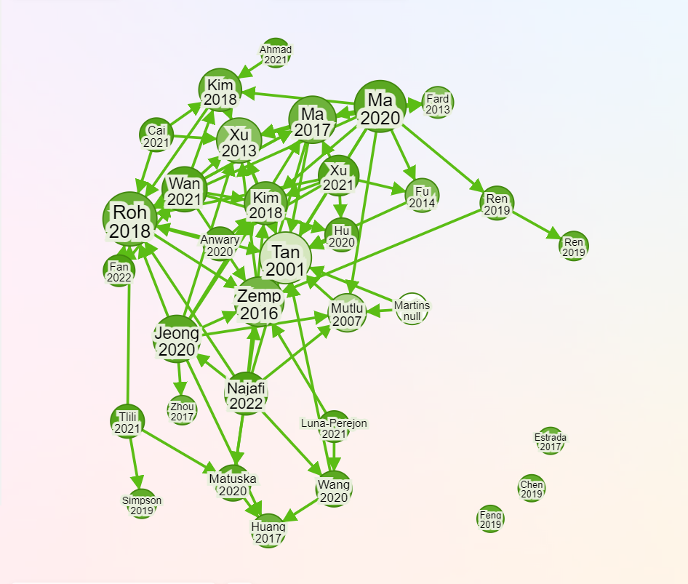
NETWORKS

Slide 8
What I found out so far.
Most studies are using ANN and CNN ML models for posture classification
Force Sensitive Resistors (FSR) are among the most used sensors.
The total average of sitting posture is 7. The most was at 15
The greater the number of postures, the less accurate it is.
Low quality of testing data
Most of the studies don’t focus on the user feedback aspects

Slide 10
Thank You

